Slide 1


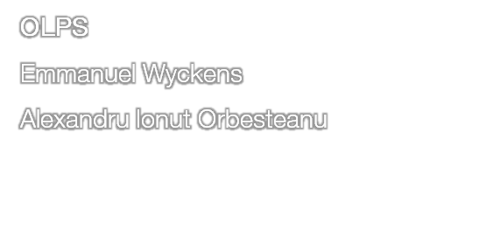


Slide 2
Current context
Orange Spain agreements allow to provide contents in catchup TV for channels broadcasted on Orange TV, but only few contents are proposed.
OSP already operates a catchup service “TV à la carta” (also available through the EPG browsing past programs), but:
  the catalog is operated manually (content ingestion & EPG)
  content not available after program is over in live
interne Orange

Slide 3
Introduction of automatic catch-up
Objective:
Live video channels, recorded entirely for 7 day period
Catch-up content automatically provisioned from this recording (no manual ingestion needed)
The catch-up content is available near-live, whereas with manual catch-up and EPG ingestion takes time
Transparent migration in user experience, as all content will be available to the user via either Tv à la Carta or the EPG grid.

Slide 4
What is the VSPP?
VSPP is a storage/packaging/transcoding component developed by Fabrix (now Ericsson);
It allows the storage of live video content for a determined period of time; Resiliency is assured by breaking sharing the assets of different nodes. In case of individual node failure, all information will be kept.
Live channels are recorded in a rolling buffer for a set period of seven days.
It features just-in-time packaging/encryption of the content with a key provided by various KMS vendors.
Catch-up content can then be delivered from the storage clusters either directly to the user or through a CDN.

Slide 5
Recording features facilitated by VSPP
Catch-up: See a program that has ended (yesterday’s episode from a TV series)
Start-over: Go back to the beginning of a program currently shown on Live TV.
nPVR: Programmable recording of a future program, to be at the user’s disposal for the next 60 days after shown on TV.
Series catch-up: All episodes in a TV series will be stored (as a VOD) for up to one year.

Slide 6

Deployment of VSPP component 1/2
SAT
Live Origin Server
+
Encryption
Encoding (MSS + HLS) –
Capture
Get Live content chunks
on-demand by end users if not cached
FTTH
Manifest
Orange CDN
Key Manager from Viacces
Licenser
I2 : Get Key to encrypt Catchup contents
I3 : Get catchup content chunks
on-demand by end users if not cached
New
I1 : Get all the live stream and record them in the rolling buffer
Manifest
Orange
VSPP
Storage
Deployment of the VSPP component wit 3 interfaces
=> Interface with Live Encoder to record the live stream during a period (in the rolling buffer : 7 days)
=> Interface with CDN : VSPP is an Origin Server for the catchup ,service (later all Near live and live services)
=> Interface with KMS : VSPP is packaging the content on the fly and so retreive a Key from the KMS

Slide 7



Static view
Using the streaming capacity of the VSPP component we also benefit from the transcoding and packaging function on the fly
New FQDN to create in the CDN for catchup service (in addition to live and VOD)
(update on configuration)
TVE Apps
Smartphone
Orange CDN
Orange
VSPP
Streaming
Get catchup content chunks
on-demand by end users if not cached
Tablet
Streamer
Storage
GetPlayingInfo
Request licence
Get Played URL
(partage d’information entre le CDN et RTV pour la génération d’URL)
Streaming
RIGHTV
AR
RTE
GetPlayingInfo
Request licence
BD
STB
Update
rule to calculate URL is modify to generate an URL pointing to the VSPP component and not the live or VOD OS (update on VSPlugin)

Slide 8




Rolling Buffer model – Pause Live TV use case
Channel n
Channel B
Channel A
Pause was pressed
Delete old chunk and write new one to the buffer
Resume was pressed
Live availability
In CDVR level , the live program is available after 2 GOPs (GOP: Group of successive pictures. Ex: 25 Pictures per second ➔ GOP of 2s = 50 pictures)
The rolling buffer erases automatically the oldest chunk after the configured retention period.
No storage into the grid

Slide 9






Rolling Buffer model and Inner Asset Block – Record TV use case
Inner Asset Block Never locked
No Backup~ Delete action
Channel n
Inner Asset Block n+4
Inner Asset Block n+3
Channel B
Inner Asset Block n+2
Inner Asset Block n+1
Inner Asset Block n
Asset Block n+3
Asset Block n
Channel A
Delete after retention period or delete by the user
Asset Block n+2
Asset Block n+1
Grid storage
Instant, Time based, EPG record done by the users
End of the record
The Asset Block
The asset corresponding to X Chunks for several minutes. The asset duration is fixed 30 minutes. (best trade off for accessing Database)
The asset is locked and stored into the CDVR over x days (example of retention period)

Slide 10












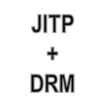
























JITP: Just In Time Packaging + DRM
Ericsson VSPP
GET http://node1/shss/LIVE$FOX/2.ism/
manifest?device=SMOOTH
Akamai CDN
GET http://node1/shss/LIVE$FOX/2.ism/
manifest?device=SMOOTH

Slide 11









Traditional OTT system
HTTP Server
Notes:
2016-01-11
VSPP Streamer OTT
, Rev

Slide 12

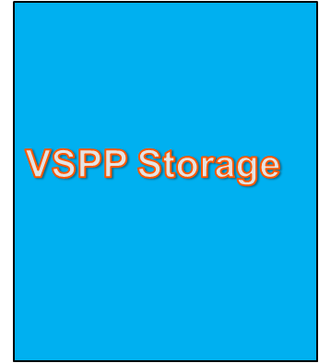


VSPP using JITP (just-in-time packaging)
Encoder
MBR TS
Just In Time Packaging
HTTP Server
Notes:
2016-01-11
VSPP Streamer OTT
, Rev

Slide 13
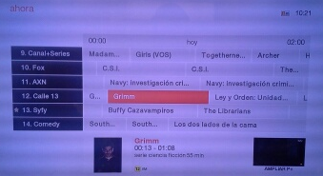
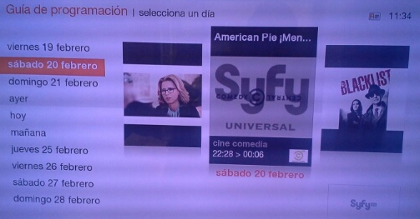
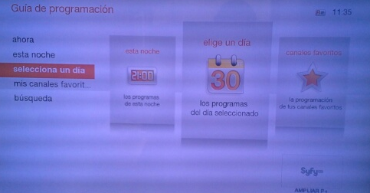
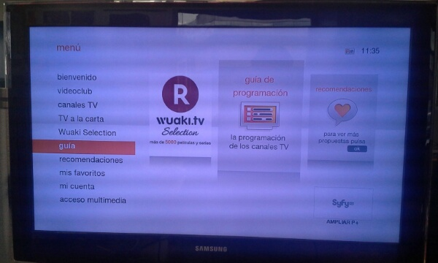
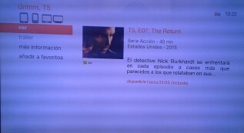
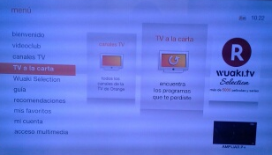
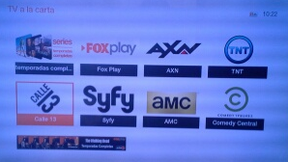

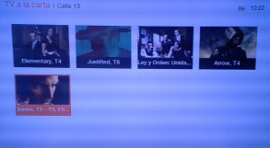
Current user experience for catchup TV within OSP*
guia
Today, contents that are available in catchup are displayed in black in the EPG grid, and selectable
User browse the EPG for passed programs
Shortcut to the video presentation page in “TV a la carta”
A
OK
OK
OK
EPG Grid
OK
Passed programs
Selecciona un dia
Main Menu
User browse “TV a la carta”
OK
Home of “TV a la carta”
B
The video presentation screen allow to launch the content playback.
Tree browsing
Today, catchup contents are also available in “TV a la carta”
OK
OK
“TV a la carta” allows to browse catchup content by channels
Catchup contents of each channels are displayed by series / programs
*This is the current user experience in production for catchup contents that are manually provisioned into RiGHTv by OSP contractors.
MIS

Slide 14
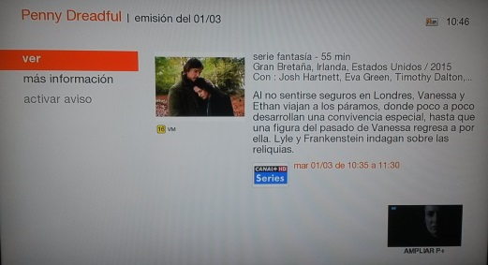


Evolution on user experience for catchup TV from the EPG
IF the VPS is not available but the tag indicate the rights to access to this content
=> display the program info screen
If the program is accessible in catchup activate the VER button
When customer click on VER button launch the live program in the past according to the program ID
Update
contents that are available in catchup are still displayed in black in the EPG grid, and selectable
guia
A
Update
User browse the EPG for passed programs
Detect the Rights to access the program in catchup
If the VPS (IDDList EF is not available) display the program info
OK
OK
OK
EPG Grid
OK
Passed programs
Selecciona un dia
Shortcut to the video presentation page in “TV a la carta”
Main Menu
User browse “TV a la carta”
Home of “TV a la carta”
OK
The video presentation screen allow to launch the content playback.
Tree browsing
Today, catchup contents are also available in “TV a la carta”
OK
B
OK
“TV a la carta” allows to browse catchup content by channels
Catchup contents of each channels are displayed by series / programs

Slide 15
Back Evolution
In new architecture, VSPP enabler:
  Records all the live stream (automatic catchup recording)
  Streams this content
Impact on existing components:
CMS:
  The EPG metadata flags a certain program as catch-up enabled;
  Specific XML to describe the VPS to associate to the catchup content without the media video (as the content is stored by VSPP)

Slide 16
Future evolutions
Though the current focus of this One-Roof workshop is the integration of automatic catch-up with all components, through tweaks in the apps/RAs, the VSPP component can be easily used to provide Start-Over and later NPVR features

Slide 17

Questions?
interne Orange

Slide 18

Thank you!

